Slide 1
Detecting and Fetching License numbers from moving vehicles
Krishnakant Modani
(Individual Project)
Mentor : Prof. Jana Kosecka
George Mason University

Slide 2
Introduction
Automatic License Plate Recognition is a pivotal tool in modern traffic systems and security operations.
Utilizing a combination of artificial intelligence, computer vision, and image processing techniques, these systems can detect license plates on moving vehicles across various environments and conditions.
The integration of such smart systems into broader traffic and security management frameworks helps increase efficiency, enhance public safety, and streamline operations in urban settings.

Slide 3



Models and Libraries Used

Slide 4
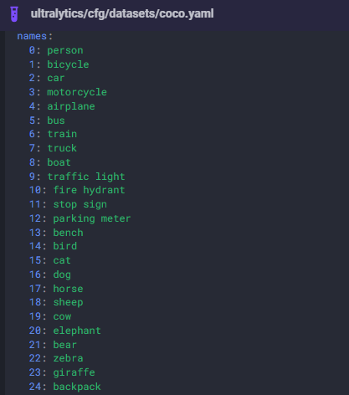
Models
Yolov8 – A deep learning model usually used for object detections. It has around 80 such objects that can be detected till date.
In our case, we’re using it for vehicle detections.
You can refer the link below :
https://docs.ultralytics.com/datasets/detect/coco/#dataset-yaml
Just for additional info : This model has been trained on the coco dataset.
License Plate Detector – A pre-trained model trained on the dataset provided by roboflow :
https://universe.roboflow.com/roboflow-universe-projects/license-plate-recognition-rxg4e/dataset/4

Slide 5
SORT library – Algorithm for vehicle tracking throughout the video.
It assigns every car object a tracking id, which can be further used to identify the same car in every frames, using that tracking id.
Reference link : https://github.com/abewley/sort
EasyOCR library – Used to extract the texts from the processed license plates.
CV2 library – Used for loading video and minor processing of the images (in the form of frames)

Slide 6
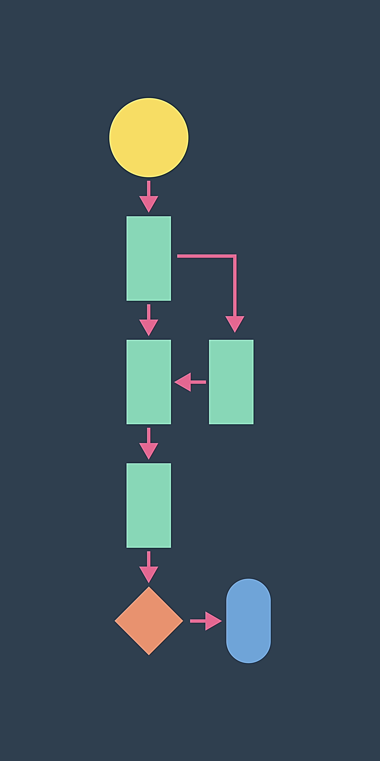
Approach (System Workflow)
Image source : https://www.getclockwise.com/blog/how-to-create-workflows

Slide 7
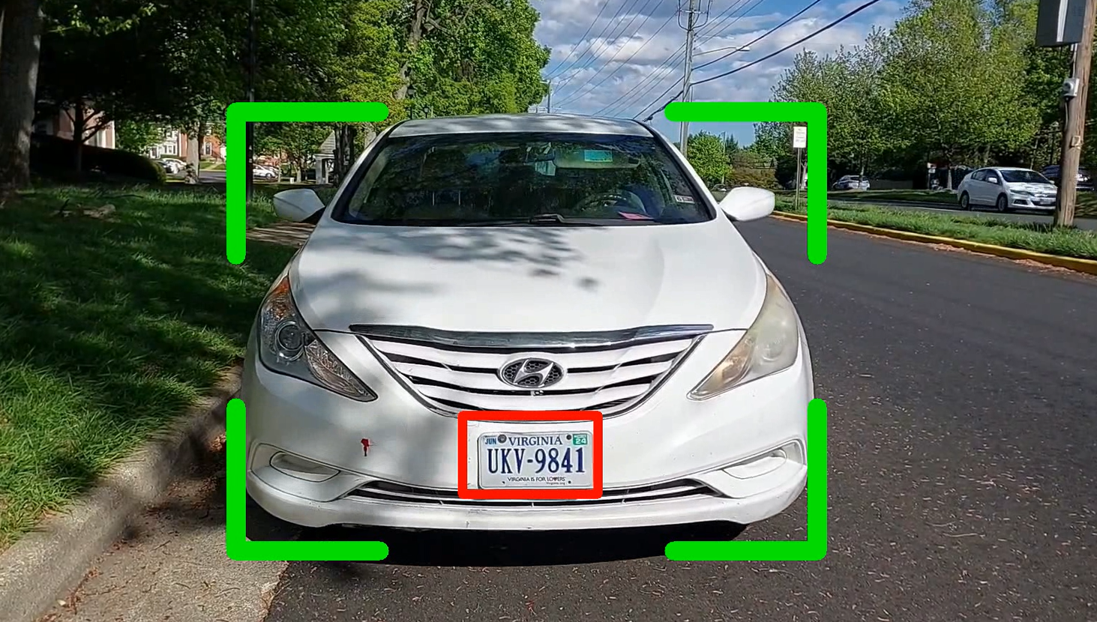
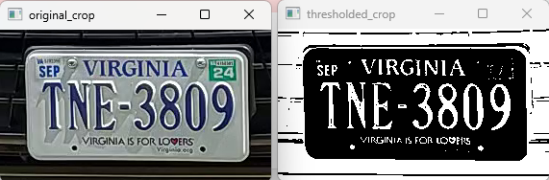
Loading the video using OpenCV library and dealing with each frames.
Using the yolov8 to detect vehicles in each frames.
Tracing the vehicles throughout all the frames using SORT. We’re recognizing the same car in every frames with the help of the tracking Ids assigned.
After detecting the cars, we use our license detector model, which strictly detects license plates for each vehicles.
Thresholding each cropped images of plates using the OpenCV library.
Makes it easy for easyOCR to extract texts from the processed plates.
Once the texts are extracted from the plates, we’re writing it to the csv file for our analysis.
( Note: This is just for the demonstration of bounding boxes )
( Note: This is not the screenshot of license plate of above car. This is just for demonstration )

Slide 8
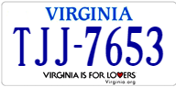
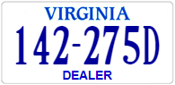

ProblemS
1. Different License Formats :
Every states in the US has its own license number format for some reasons.
For e.g. Virgina has mainly 3 license plates formats segregated as
Standard Passenger Plates (e.g. ABC-1234)
Specialty Plates
Personalized Plates
Why does it matter to us?
It is important to separately identify them, as license plates not just contains license number, but might contain some other texts, or images with texts as well. That might also get captured during our text processing step.
Moreover, it also helps in quick identification of any state licenses.
How are we dealing with this?
For this project, I’m strictly focusing on “Standard Passenger Plates” format for detection.
Checking for license compliability accordingly, bypassing the other formats.
Image source : https://licenseplates.cc/VA

Slide 9

Data Visualization
( Slight look at our data stored in CSV file )

Slide 10
Missing Frames
Reasons ?
Due to some of the captured blurred images, which the OCR might not have detected the license text properly.
Non-compliance with our license format. (e.g. 1234VH is bypassed)
Effects : The effects can be seen in the visualization video, wherein the bounding boxes flickers.
Possible Fix / Future Scope : Idea of interpolating the missing frames, by taking averages of data from the initial and post frames! (Note : Couldn’t implement this in the project due to time constraints, as well as it’s just for the smooth transition in video)

Slide 11
Time FOR SHORT Video!!!
Links :
Original Video : https://youtu.be/zlbq5F5NxQQ
Model Output Video: https://youtu.be/urwZYRWwvNs
Note :
I couldn’t record the real traffic video due to the low camera quality of cell phone.
Although, I still tried capturing, but the cars speed seemed too fast, when seen from the ground level, due to which the model doesn’t get enough frames to analyze it. This would be much more effective, if we would have a front view, slight from the top!
For showcasing, I came up with these ideas –
Slowly moved camera on parked vehicles, to ensure smoothness and clarity.
With a owner’s permission, captured a video of a car that came in for parking. XD
Finally, attached all these videos together.

Slide 12

Thank you

